Slide 1
Flipping the Classroom
Blended Learning in Search of Better Outcomes

Slide 2
Testimonial…
….“I flipped my classroom about half a dozen times last semester. I found the teaching experience to be much more effective from my end when I did this. More importantly, the students truly believed they learned better when they had more than one shot at trying to understand what I was trying to communicate. They appreciated the opportunity to just listen the first time, then go back and take notes on that which they did not understand. Class discussion of the problems based on their reading and working through the lecture I posted was noticeably enhanced both in terms of the quality of the discussion and the number of students who participated. My sense is that "weaker" students especially benefitted when I flipped the classroom.”
Pat Reyhan

Slide 3
Key Questions
What is it?
Does it work?
How hard is it compared to more traditional approaches?
How do I do it if I want to try?

Slide 4
What is It?
Let’s start with an example…
Notes:
Also – “blended” learning – where the traditional classroom is face-to-face. The “blended” classroom can include both face-to-face and virtual (on-line, ex) elements. A 1988-2009 study by the US DOE reported in its meta-analysis that students in blended environments performed better than those in a purely virtual setting, and somewhat stronger that students taught solely in face-to-face environments. http://www2.ed.gov/rschstat/eva;/tech/evidence-based-practices/finalreport.pdf . The cohort, though, included students k-12.

Slide 5

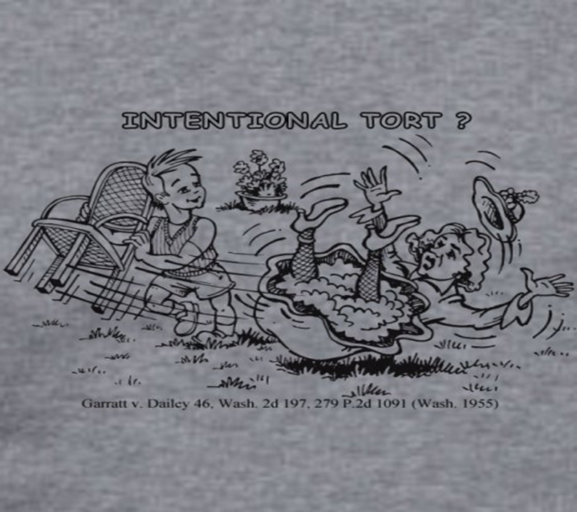
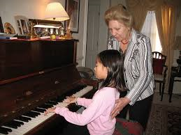
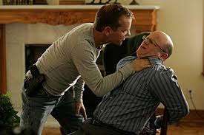
Intentional Torts Require as an element Intent
Intent is an every day word, but here, “intent” will be defined for purposes of intentional torts.
Not a single “definition,” but on a spectrum, some or all of which may meet the definition for intentional torts.
Evil intent to cause serious harm →→→→→→innocent intent to cause trivial contact with person. So, consider whether the actor has “intent” and what that intent is when:
Notes:
Recall that torts have roughly the same structure: the P must plead and prove her prima facie case by a preponderance of the evidence and if P does so, P wins unless D pleads and proves an affirmative defense. The structure of a prima facie cae for all torts requires P to plead and prove:
D engaged in requisite tortious conduct
Causation
Damages
(each category may have sub-parts or alternatives)

Slide 6
Sources of interpretation of “intent” RT 1 & 2; Garrett
Restatement of Tort 1 § 29
An act, which, directly or indirectly, is the legal cause of a harmful contact with another’ person makes the actor liable to the other, if
  A. the act is done with the intention of bringing about a harmful or offensive contact or an apprehension thereof to the other or a third person, and …
    Comment (a) – character of actor’s intention. In order that an act may be done with the intention of bringing about a harmful or offensive contact or an apprehension thereof to a particular person, either the other or a third person, the act must be done for the purpose of causing the contact or apprehension or with the knowledge on the part of the actor that such contact or apprehension is substantially certain to proceed.
Intent to harm/offend – yes. Anything else?
Here, the Garrett decision discusses the interpretation of “intent” in the context of battery.
Notes:
RT1 – 1939; RT2 – 1964; RT3 began in 1992, some parts complete, but intentional torts are still in progress. RT3 leaves intact many sections of RT2. RTs look like black letter rules, but are not statutes & are not primary authority. They are not binding, but are highly persuasive. The come from the ALI and are the result of expert synthesis of the work products of state and federal courts to determine what is the “best” governing rule.

Slide 7
In reading the decision, Garratt v. Dailey 279 P.2d 1091 (Wash. 1955) consider
What the last few paragraphs tell you.
What happened so far in litigation. What has to happen after this decision?
What main issue did the court address? Was this a question of what the law meant? If so, what were the possible meanings for the relevant term?
The court gives some suggestions for facts that might establish the relevant term or not; these suggestions are dicta. What were the suggestions?
What was the “side” issue?
Structurally – battery is an element based rule. How did that structure affect the way the court reasoned?
What was/were the source(s) of the rule used by the court?

Slide 8
Intent to ???
RT1 & 2 “dual” intent
  Intend to cause the harmful or offensive contact
    Jack Bauer
  Intend to cause the contact knowing with substantial certainty that the contact will be harmful of offensive
    Garrett – child pulling chair from under adult
  (And contact that is harmful or offensive occurs)
RT3 section 101 & 102 require that the
  “actor intends to cause contact with another” [single intent]
    Piano teacher?
  & the contact
    causes bodily harm or
    is offensive (to a reasonable sense of personal dignity) – which is defined using an objective standard.

Slide 9
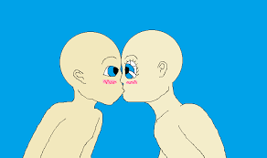
Hypo I
A, an immigrant from country x, is visiting America for the first time. In X, when taking leave from a friend or acquaintance, it is customary for the parties to kiss. A met B, a stranger in a bar, and chatted amicably for half an hour. When B got up to leave, A planted a kiss on B’s cheek. B was so taken aback that he fell backward and injured himself. Has A committed a battery?

Slide 10

Hypo 6
A sends B a box of chocolates. A made sure that one out of every six chocolates is poisoned with arsenic. B eats several of the non-poisoned chocolates and is unaware that poisoned chocolates are in the box. A later informs B that poisoned chocolates were in the box. Has A battered B?

Slide 11
So…
What does it mean to flip a classroom, engage in blended learning, and promote active learning?

Slide 12
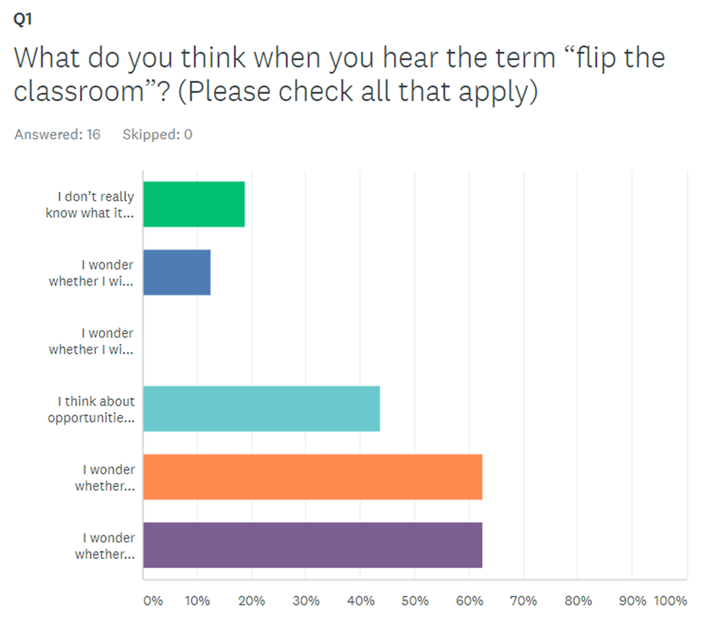
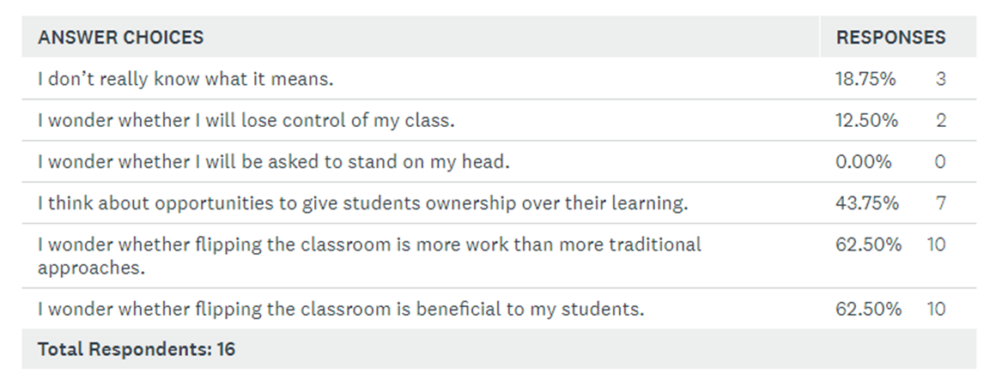

Slide 13
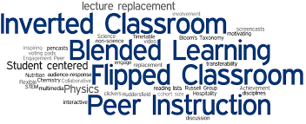

Slide 14
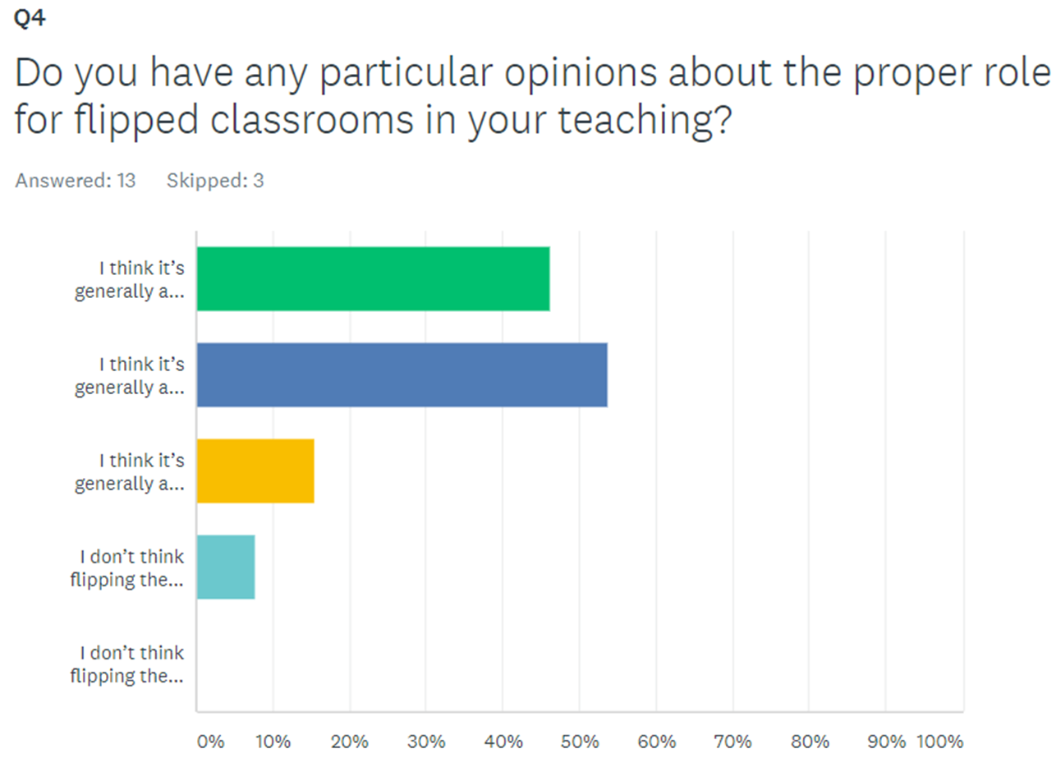
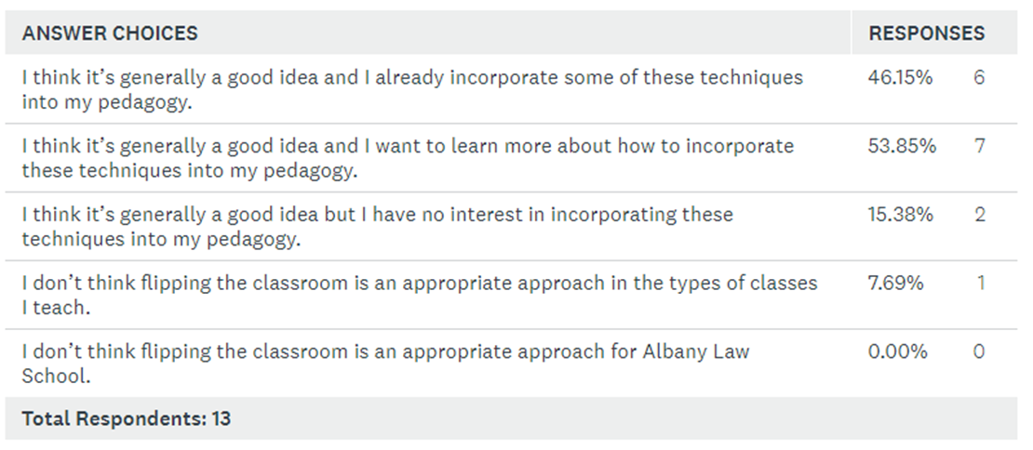

Slide 15
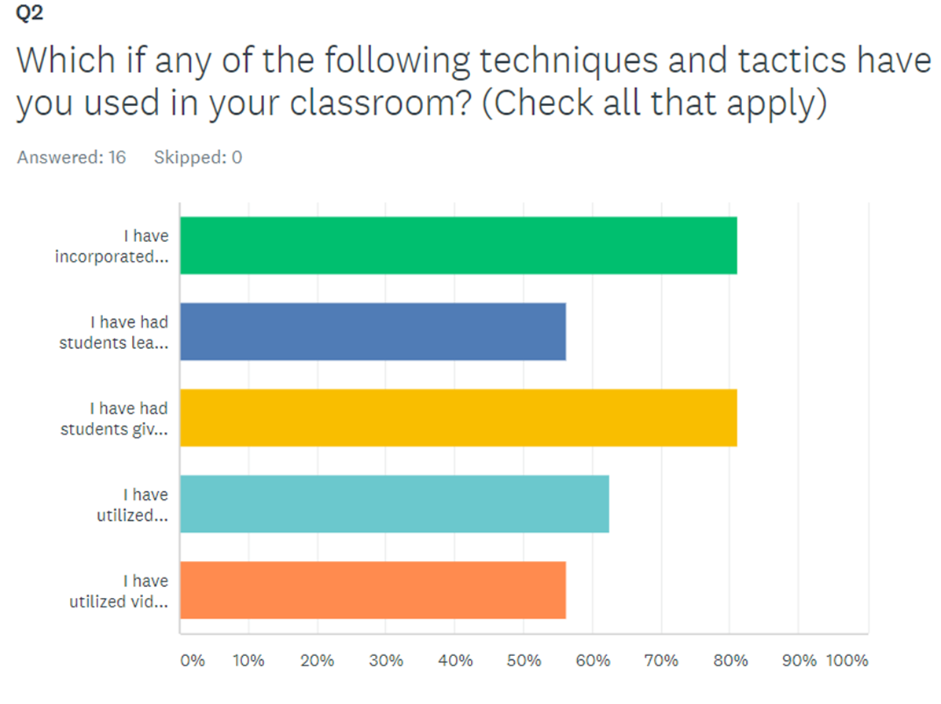
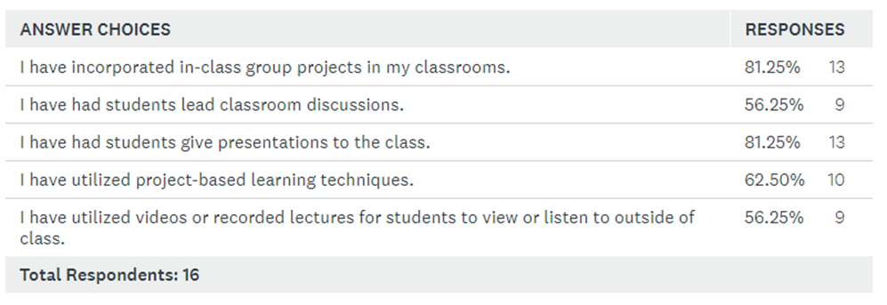

Slide 16
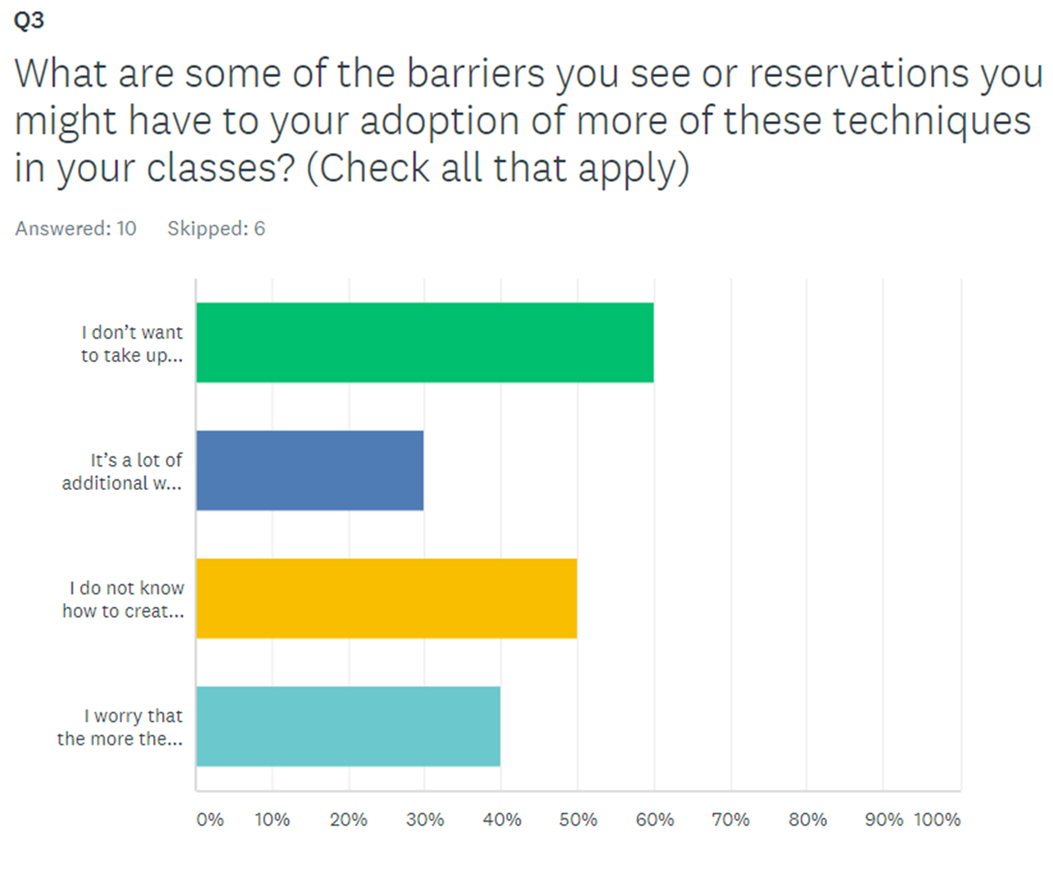
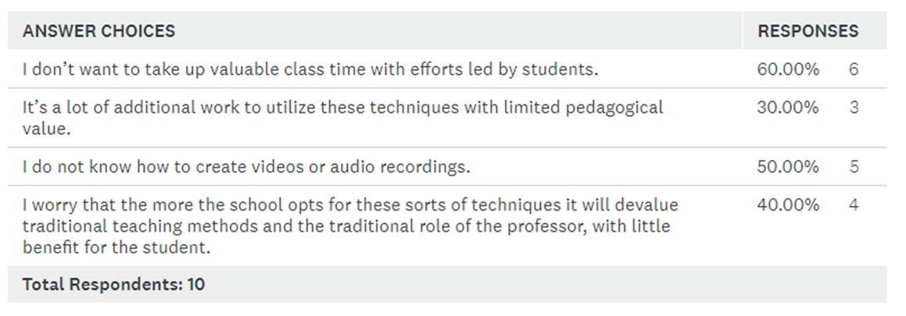

Slide 17
Barriers, Continued (comments)
I don't know which techniques will yield the highest positive impact in student learning.
I truly believe that flipping the classroom makes the classroom teaching more rather than less relevant.
Students can miss a traditional lecture, but it’s hard to make up a missed, flipped classroom.
It does sound like more work but I wouldn't presume that the value is limited.
When I have used out of class audio or video recordings I've felt compelled to essentially represent the material when there are students who are not fully up to speed, so the effort seems wasted.
It's more that I'm not sure how to make it work -- I'm still very new at this!
Will students actually watch the videos? Will out-of-class videos be any better at engaging students if traditional lectures don’t?
I've found that it can be difficult to bring a class back to where it needs to be when a student is in charge of discussion and the discussion goes awry.
Re additional work: this is a fear more than an experience (but something of an experience as well).
I worry about ownership of online and other pre-prepared content.

Slide 18
So
DOES IT WORK?

Slide 19
Benefits: The Theory
Maximize Class Time: uses out-of-class time for imparting of information – in-class time for questions/problems/discussion.
Learning Can Happen Anywhere, as Can Mastery: Students can review out-of-class lectures multiple times throughout the semester.
Engages Students in the Process of Learning How to Learn in a Complex and Rapidly Changing World: In what Thomas Friedman calls the “Age of Accelerations,” instead of seeing instruction as imparting information, seeing it as teaching students how to learn to prepare them to be lifelong learners, to enable them to adapt to the evolution of the law and of society.
Different Students Have Different Learning Styles: Different students respond to different approaches in different ways.

Slide 20
In helping students to learn law
Consider learning style -
  a learning style represents an individual’s “way of thinking, processing, and understanding information.”
  The concept encompasses both
    (1) the differing ways in which individuals perceive and absorb new information (i.e. the process of cognition, or the acquisition of knowledge), and
    (2) the disparate ways in which individuals process and catalog new information (i.e., the process of conceptualization, in which new connections are formed and new ideas are conceived) for access later.

Slide 21
Just for the moment –
Don’t get hung up on the Monty Python-like “when I was my students’ age, I walked to school in bare feet after eating cold gravel for breakfast . . . and learned law . . . .”

Slide 22
It just happens that students coming to law schools now come from very diverse backgrounds and yet, have generally developed learning styles that prefer “active” and “experiential” learning.
These learning preferences do not mean students don’t learn otherwise.
But, because of the way many students now perceive, absorb, process, and catalogue information, memory access may improve with active rather than passive learning.

Slide 23
Working Memory
Working memory capacity is the amount of information that can be held accessible. Relies on the ability to access both long and short term memory.
Analogizing somewhat to computers –
  Information is stored both in the “hard drive” as, say, programs and OS. Think of this as long term memory.
  Information is also stored as RAM. RAM is memory on the hard drive that is being used; it is flexible and clears once a program is closed. (short term)
How well a program runs overall depends both on working memory and processing speed.
The more RAM and the higher the processing speed, the more sophisticated and complex the processing and ability to make full use of the programs, and more programs can be run simultaneously.
So – the more students are able to add to their own “RAM,” the stronger their own analytic skills can be
Notes:
Short and long term relationships –
Short term – studies tend to suggest short term memory is lost at a rate of 25 % every 24 hours. If not lost, the memory becomes fractured. Very quickly inaccessible.
Long term memory – tends to be “chunked,” and access may depend on clues or be uneven (chunks)
Atkinson & Shiffrin - flow of information from sensory input to long-term has to pass through short term – registered by sensory receptors
Baddeley-Hitch – dynamic concept of “working memory”
Memory –
Short term storage has the function of enabling complex cognitive activities requiring integration, coordination, and manipulation of information.
Use executive function to determine what to store and what mental processes to use to store.
Executive function requires verbal information and visuospatial information to coordinate (work) for learning, storage, and retrieval.
And this or Atkinson & Shiffron’s “flow from sensory input” is where “active learning” comes in.
Sources:
Daneman & Carpenter, 1980
Kane & Engle, 2002; Kyllonen & Christal, 1990)
R. C. Atkinson and R.M. Shiffrin, “The control of short-term memory.” Scientific American, Aug. 1971, Vol. 225 No. 2. - on the relationship of short term and long term memory (flow of information from sensory input to long-term has to pass through short term – registered by sensory receptors & rehearsed.)
Baddeley, A.D., and Hitch, G.J. (1974) Working memory. In G. Bower, ed., The psychology of learning and motivation (Vol. VIII, pp. 47-89). (New York: Academic Press.)

Slide 24
Remembering (Knowledge) Recall learned info (Memory) | Understanding Comprehend the meaning – state in own words Some of the other “programs”→ | Applying Use concept in new situation → | Analyzing Separate into component parts to understand organizational structure → | Evaluating Make judgments about value of ideas or materials | Creating Build pattern from diverse elements; form whole from parts; create new meaning
Defines Describe Identify Label List Recall Recite Report Reproduce State Quote (know the rules) Memorize | Comprehend Discuss Explain Restate Summarize Translate (Explain in own words) Paraphrase | Apply Associate Calculate Compute Manipulate Modify Relate (Use rules to calculate) Analogize | Compare Contrast Diagram Deconstruct Differentiate Discriminate Distinguish Organize Outline Order (Recognize logical fallacies; select information) Analyze | Appraise Criticize Critique Defend Evaluate Interpret Judge Justify Predict Predict (Select most effective solution; explain & justify) Critique | Categorize Combine Construct Extend Formulate Hypothesize Integrate Limit Modify Re-arrange Reconstruct Write (Integrate material to solve a problem; revise to improve) Advocate

Slide 25
So, if we accept that some students are able to perceive, absorb, process, catalog information differently, then some version of working in class to put in play information conveyed previously is a viable option because it allows students to practice active, rather than passive learning.
Notes:
“Flipping” is a relatively new term. Although variations of preparation for use in the classroom models have existed (think Socratic), two chemistry teachers from Colorado are referred to as the originators of the modern concept of “Flipped Learning.” The story behind their work is that the teachers became concerned that athlete-students missed end-of-day classes to travel to other schools for competitions, games, or other events. Out of that concern, the teachers began to live video record their lectures and demonstrations, and post slide presentations with annotations. What was particularly significant was that the teachers discovered software to screencast and to record PowerPoint presentations. They recorded and posted their live lectures for students who missed class.

Slide 26
Sources on Memory & Learning Theory
Daneman & Carpenter, 1980
Kane & Engle, 2002; Kyllonen & Christal, 1990)
R. C. Atkinson and R.M. Shiffrin, “The control of short-term memory.” Scientific American, Aug. 1971, Vol. 225 No. 2. - on the relationship of short term and long term memory (flow of information from sensory input to long-term has to pass through short term – registered by sensory receptors & rehearsed.)
Baddeley, A.D., and Hitch, G.J. (1974) Working memory. In G. Bower, ed., The psychology of learning and motivation (Vol. VIII, pp. 47-89). (New York: Academic Press.)

Slide 27
Some fairly standard “flips” after a “lecture”
Short in-class quizzes to assess whether material was covered pre-class.
“feedback” quizzes outside of class as student go through lessons (like the anti-harassment presentations)
Short hypotheticals – for discussion (small group/class-wide – both)
Short written responses shared.
Generally, students have commented that videos before class help them to organize puzzle pieces and allow them to write less, but take better notes, and have formed questions for class.
Notes:
Student respond to web-based questions before class and the professor uses in class feedback a. to inform own teaching; b. for peer instructions; c. for group instruction.

Slide 28
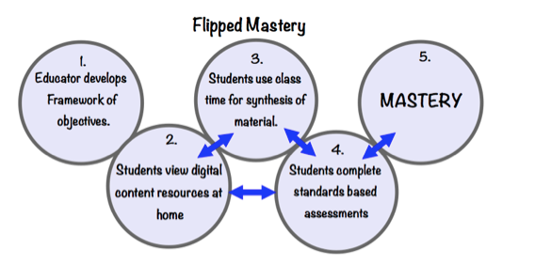
Flipping with Out-of-Class Videos: Helps Build Mastery

Slide 29
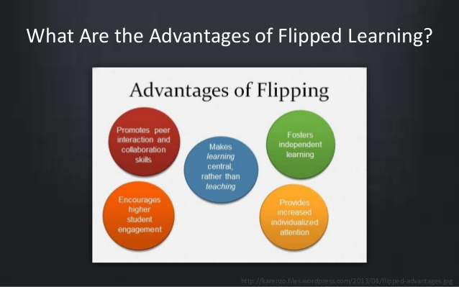

Slide 30
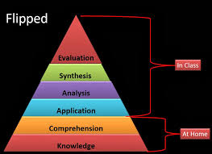
Bloom’s Taxonomy of Learning Domains

Slide 31
Our Learning Outcomes for JD Graduates
Demonstrate foundational knowledge and understanding of substantive and procedural law.
Demonstrate ability to communicate effectively in the legal context, in writing and orally.
Demonstrate basic legal research, legal analysis, legal reasoning and problem-solving skills.

Slide 32
Benefits: The Albany Law Experience
Some student testimonials…
The weekly videos were extremely helpful and indicated the bigger picture when it came to the assigned readings for that week.
The weekly videos also precipitated my learning of tough issues, and having them to review frequently was beneficial.

Slide 33
Benefits: The Research (Still Evolving)
Students were required to watch narrated PowerPoint videos and complete a worksheet before class time. In class, students participated in alternating ten-minute mini-lectures and five to seven minute active learning exercises. This led to a performance increase of 21% on exam questions related to the topics introduced outside class with videos.
M. Moravec, A. Williams, N. Aguilar-Roca, and D.K. O’Dowd. Learn before lecture: a strategy that improves learning outcomes in a large introductory biology class. CBE-Life Sciences Education, 9(4):473–481, 2010.
Faculty taught concurrent experimental and comparison sections of the course, and matched sections on topics, assignments, and time on task. Students in the experimental section watched narratedPowerPoint videos outside of class, and participated in interactive learning activities inside class. Students in the flipped environment scored significantly higher on all homework assignments, projects, and tests.
J. A. Day and J. D. Foley. Evaluating a web lecture intervention in a human–computer interaction course. IEEE Transactions on Education, 49(4):420–431, 2006.
Literature Review: J. Bishop and M. Verlager, The Flipped Classroom: A Survey of the Research, American Society for Engineering Education (2013).

Slide 34
Some more research on active learning:
See, generally, Erica A. DeGroff, TRAINING TOMORROW’S LAWYERS: WHAT EMPIRICAL RESEARCH CAN TELL US ABOUT THE EFFECT OF LAW SCHOOL PEDAGOGY ON LAW STUDENT LEARNING STYLES, 36 S. Ill. L.J. 251 (Winter 2012).
Also:
Morbert Michel, John Cater & Otmar Varela, Active Versus Passive Teaching Styles: An Empirical Study of Student Learning Outcomes, 33 SMALL BUS. INST. NAT’L PROC. 55 (2009).
Buket Akkoyunlu & Meryem Yilmaz Soylu, A Study of Students’ Perceptions in a Blended Learning Environment Based on Different Learning Styles, 11 EDUC. TECH. & SOC. 183 (2008).
Ted Brown, Tessa Cosgriff & Glenys French, Learning Style Preferences of Occupational Therapy, Physiotherapy and Speech Pathology Students: A Comparative Study, 6 INTERNET J. OF ALLIED HEALTH SCI. & PRAC. 1 (2008)
Hong Lu, Lei Jia, Shuhong Gong & Bruce Clark, The Relationship of Kolb Learning Styles, Online Learning Behaviors and Learning Outcomes, 10 EDUC. TECH. & SOC. 187 (2007).
Keith Trigwell & Paul Ashwin, An Exploratory Study of Situated Conceptions of Learning and Learning Environments, 57 HIGHER EDUC. 243, 244 (2006).
Naser-Nick Manochehr, The Influence of Learning Styles on Learners in E-Learning Environments: An Empirical Study, 18 COMPUTERS IN HIGHER EDUC. ECON. REV. 10 (2005)
Robert Loo, The Distribution of Learning Styles and Types for Hard and Soft Business Majors, 22 EDUC. PSYCHOL. 349 (2002)
G.E. Pickworth, Theories of J.L Holland and D.A. Kolb: A Theoretical and Empirical Study of Vocational Personality and Learning Style Types, Ph.D. Thesis, UNIV. OF PRETORIA, SOUTH AFRICA (1997).

Slide 35
And…
HOW HARD IS IT?...
It depends.

Slide 36
Is Flipping/Active Learning Hard or Harder than Traditional Approaches?
It depends…
Prepping out-of-class videos/podcasts CAN be harder than simply preparing for class, but that depends on how much prep you do.
Once the video/podcast is prepared though, it can be used in future years, unless it becomes stale or the law changes. If you’ve got a script and your powerpoint, those are easy to update and then re-record.
Can save some time later repeating material in class because you can suggest students watch a video over again.
Class time becomes….different.
Sometimes it might seem harder to lead an engaged discussion rather than simply lecturing, but such a discussion is likely where more learning occurs.
Review at the end of the semester becomes much more directed; students can be directed to the videos to brush up on broad themes/concepts.

Slide 37
Key Questions/Approaches Should You Want to Try This (and there isn’t one “this”)
Questions:
What is a technique you might be most comfortable using?
Do you want to experiment?
Do you like powerpoint or not?
Do you want to script your lecture or are you better just speaking with notes?
Approaches to Get Started:
Record a short lecture (using powerpoint if you do), ask students to listen out of class, and then have them prepare to answer some questions that you go over in class. Make sure the lecture matches the question!
Have students watch something from popular culture outside of class and do some issue spotting that you can discuss in class as a foil for discussing a particular issue.
Have students find examples of different issues you are addressing in class in popular culture or in the news and come to discuss them in class.

Slide 38
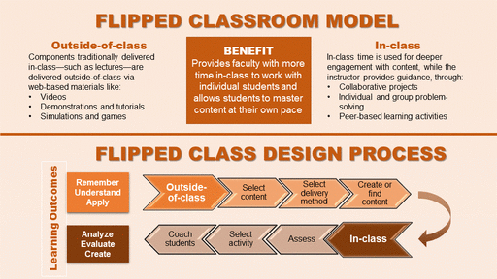

Slide 39
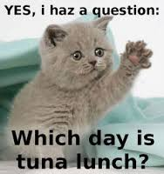

Slide 40
