Slide 1
GATHII FACULTY WORKSHOPS – SPRING 2017
Faculty Watchlist!
Teaching in Interesting Times

Slide 2
Faculty Responses to Request for Topics
Working with Students with Deficient Writing Skills
On Papers especially ULW
On Exam answers
Writing Multiple Choice Questions
Teaching during the Faculty Watchlist era
LEFTOVER FROM FALL:
how to use clickers in classroom

Slide 3
Watchlist and FOIA requests
https://bestpracticeslegaled.albanylawblogs.org/2016/12/13/adding-your-name-to-the-professor-watchlist/
Professor Watchlist, a website that seeks to “expose and document college professors who discriminate against conservative students and advance leftist propaganda in the classroom.”
The AAUP notes, “This website poses a clear threat to academic freedom. Over the past century, such lists have been used to harass and intimidate faculty, and have a chilling effect on academic freedom and free speech.”
https://bestpracticeslegaled.albanylawblogs.org/2017/01/15/public-opposition-to-jeff-sessions-results-in-an-open-records-request/
http://taxprof.typepad.com/taxprof_blog/2017/01/3-law-profs-criticize-smug-self-delusion-of-1400-law-prof-signatories-to-scandalous-letter-by-partis.html

Slide 4
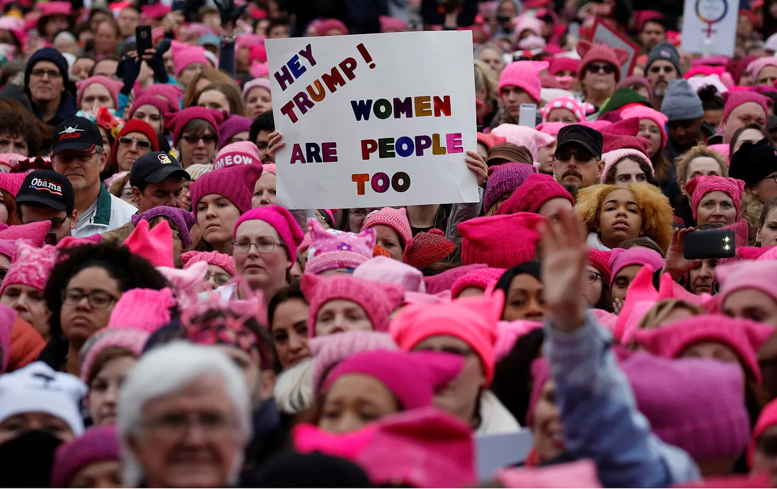
Tumultous week
Trump admin orders EPA contract freeze and media blackout
President Trump is ordering construction of a Mexican wall, and may unveil plans to curtail immigration from "terror prone" nations

Slide 5
What does this New Era mean for:
Teaching
Writing
Speaking
Community Service
Academic Freedom

Slide 6
Understanding the Election
Professor Timothy Taylor
U Albany
Former Counsel for Unions
Mediator
Notes:
EDUCATION: J.D. Cornell University Law School, Ithaca, NY, 1987

Slide 7
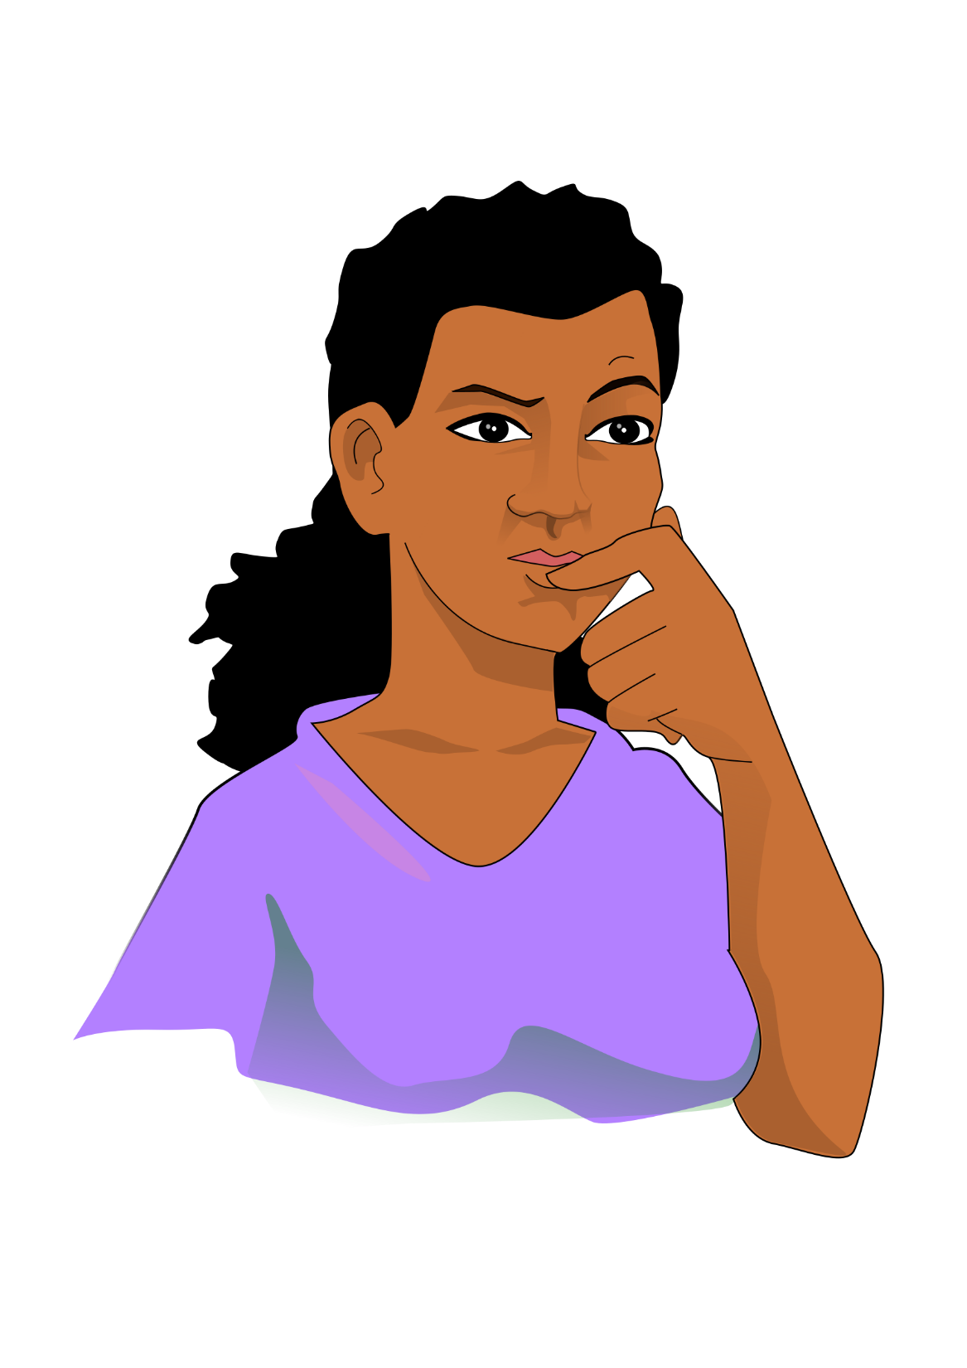
What are your thoughts?

