Slide 1
NEW RESOURCES AND NEW COURSES
Professors Christine Chung, Seve Falati, Rob Heverly,
Mary Lynch and Nancy Maurer

Slide 2
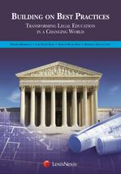
PART 1: NEW RESOURCES FOR LEARNING AND TEACHING (Lynch, Maurer)
Building on Best Practices: Transforming Legal Education in a Changing World
http://papers.ssrn.com/sol3/papers.cfm?abstract_id=2553452
http://www.cap-press.com/books/isbn/9781630443207/Building-on-Best-Practices

Slide 3
HOW TO USE – 10 New areas
this new volume is not a second edition, but is intended to be used in conjunction with the original volume
Legal education is called upon today to respond to a broader view of what lawyers must be trained to do. Building on Best Practices identifies ten such areas and provides guidance on what and how to teach them. The demand to teach a broader range of knowledge, skills, and values presents difficult trade-offs, however, that are also considered.
HANDOUT – teaching the newly essential knowledge skills and values in a changing world

Slide 4
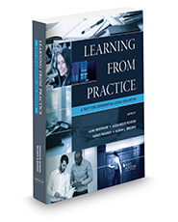
LEARNING FROM PRACTICE
Wortham, Scherr, Maurer and Brooks, Learning from Practice: A Text for Experiential Legal Education, 3rd
Direct link to information about Learning From Practice. You can link to table of contents and other info.
http://www.westacademic.com/Professors/ProductDetails. aspx?NSIID=45413
Look for Teacher’s Manual – any day!
Difference in Audience

Slide 5
PART 2: BRAINSTORMING: INNOVATIVE COURSES AT ALBANY LAW SCHOOL (Chung, Falati, Heverly)
Curatorial Studies – Professor Heverly
Transactional Practice Hybrid: transactional law with a focus on business deals– Professor Chung
Entrepreneurial Law in Emerging Technologies –Professor Falati
2 class
2 field

