Slide 1
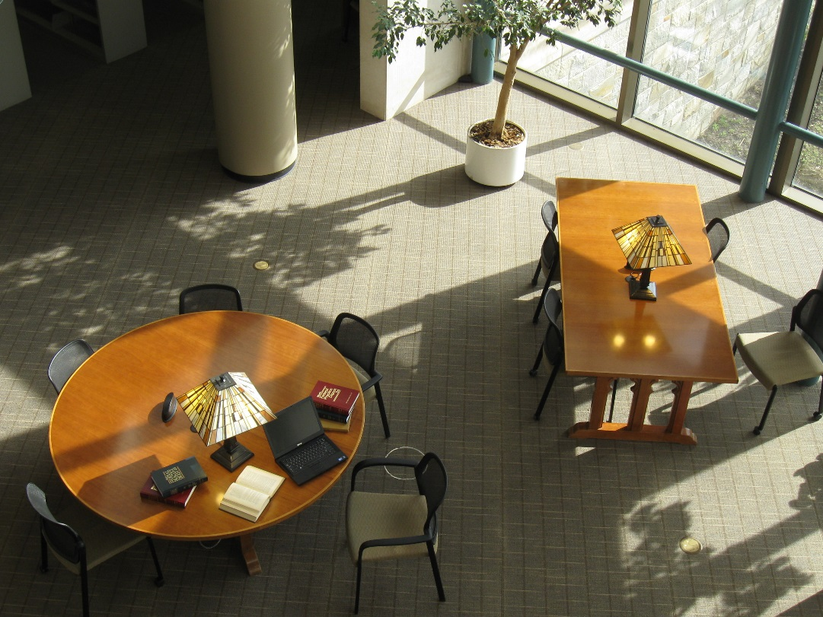

Library Services for Faculty

Slide 2
Schaffer Law Library – 2011

Slide 3
Schaffer Law Library -
Changing Times

Slide 4
Schaffer Law Library – Today

Slide 5
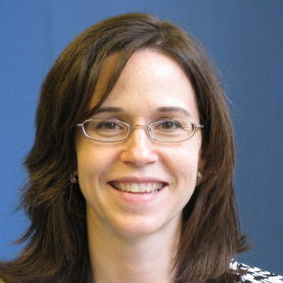
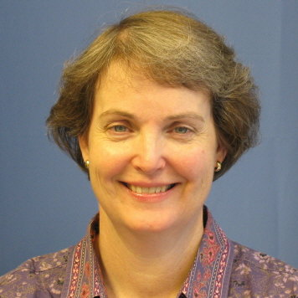
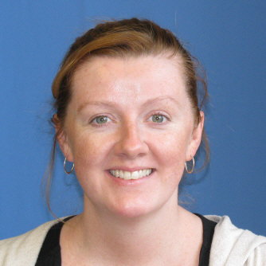
Full-time Librarians
Colleen Smith
Director
Leslie Cunningham
Catalog & Government Information Librarian
Rebecca Murphy
Technical Services Librarian

Slide 6

Full-time Librarians
Public Services Librarian
Collection Development & Management Librarian

Slide 7
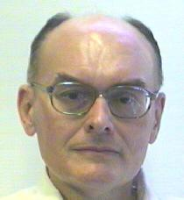
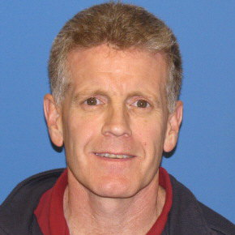
Part-time Librarians
Robert Emery
John Kenny

Slide 8
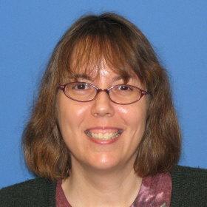
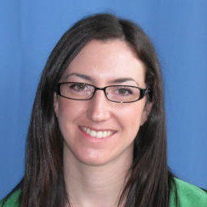

Library Technical Assistants
Lisa Suto
Public Services and Collection Maintenance Specialist
Govie Finn
Public Services and Interlibrary Loan Specialist
Allen Lescak
Legal Supplementation Specialist {Part-time}

Slide 9
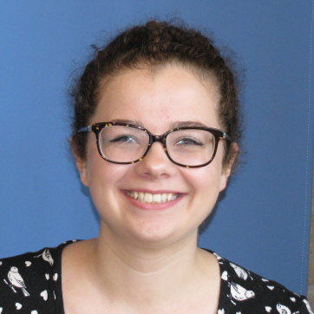

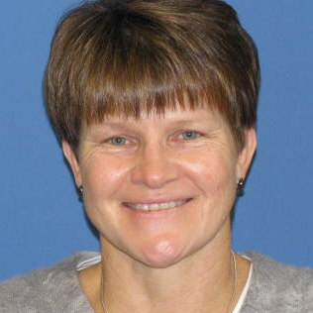
Library Technical Assistants
Melanie Mabee
Cataloging & Acquisitions Specialist
Elizabeth Conniff-Dineen
Government Documents Specialist {Part-time}
Jean Goldsmith
Continuations & Serials Specialist {Part-time}

Slide 10
Reference and Instructional Services
Reference Desk
Monday-Friday 1:00pm-4:30pm
Saturday 9:00am-5:00pm
Sunday 10:00am-6:00pm
Email: reference@albanylaw.edu
Call: 445-2390

Slide 11
Reference and Instructional Services
Obtaining information from sources outside the library
Individual and group instruction on developing research strategies for both print and electronic resources
Instruction on using print and electronic resources
Research guides on various legal subject areas
Assistance with Federal and New York State government documents
Subject-specific in-class research instruction by request
Orientation and legal research training for new law journal members

Slide 12
Interlibrary Loan
ILLiad
All requests must be made through ILLiad, our online interlibrary loan management tool.
Login to Library Portal (my.albanylaw.edu/library) and select Interlibrary Loan
ILLiad User Guide
ILL email: ill@albanylaw.edu

Slide 13
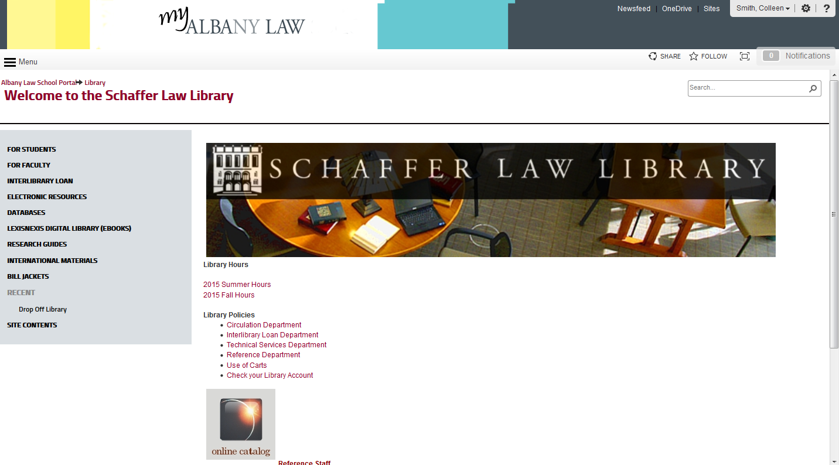
Library Portal
Notes:
Renew books

Slide 14
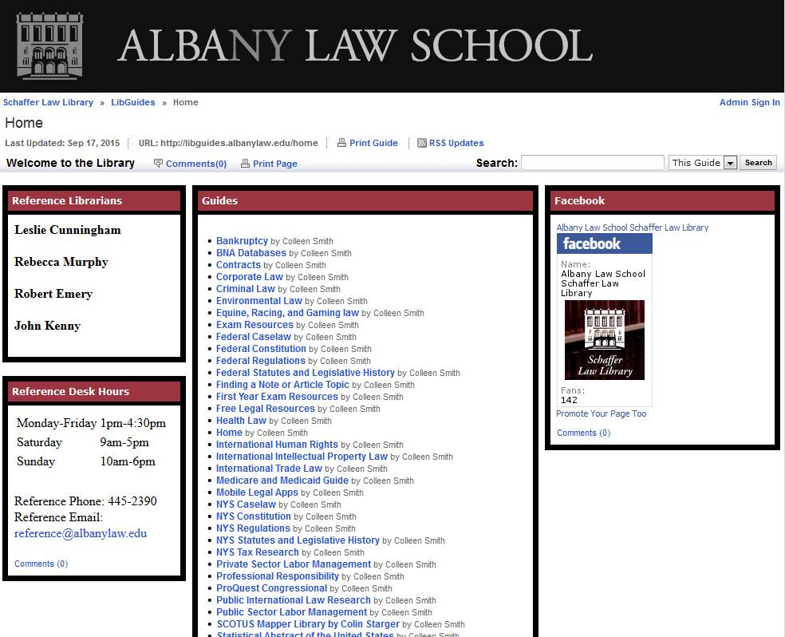
Research Guides

Slide 15
Renew Your Library Materials

Slide 16
Future areas of support & collaboration?
Support for Faculty Scholarship
  Institutional Repository?
Support for Teaching and Instruction
  Teaching and Learning Library Collection?
  Research Guide highlighting print & electronic resources
Opportunities/benefits for the library due to affiliation?

