Slide 1
PEER SUPPORT IN TEACHING SURVEY RESULTS

Slide 2
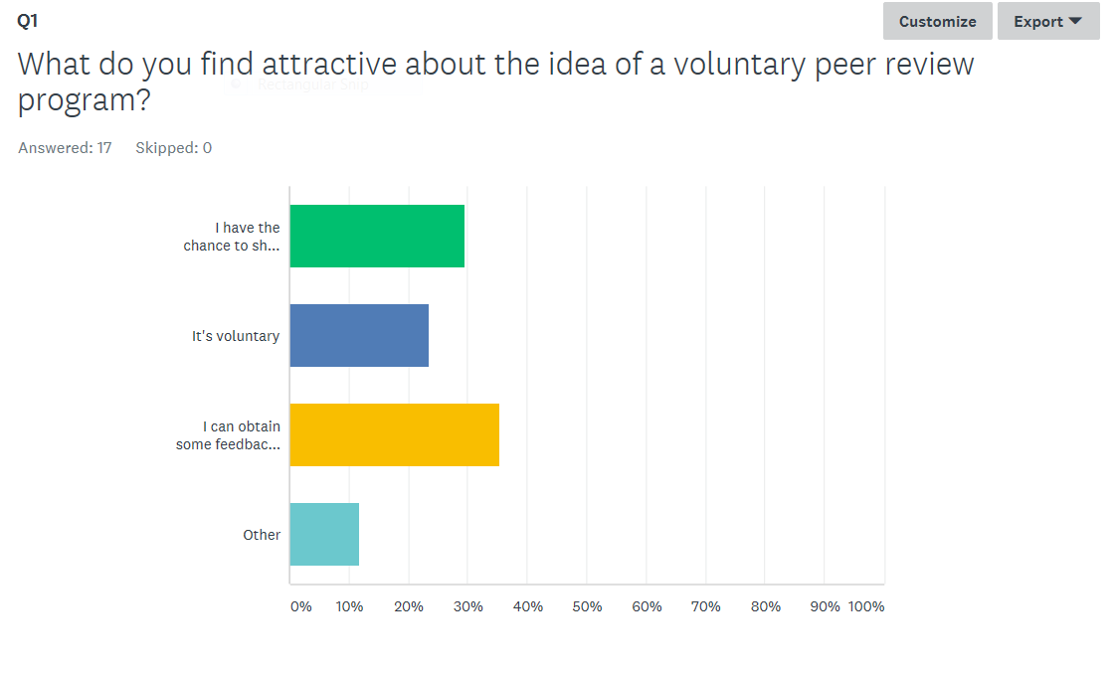
I have the chance to share teaching ideas with a colleague | 29.41% 5
It's voluntary | 23.53% 4
I can obtain some feedback to improve student learning | 35.29% 6
Other

Slide 3
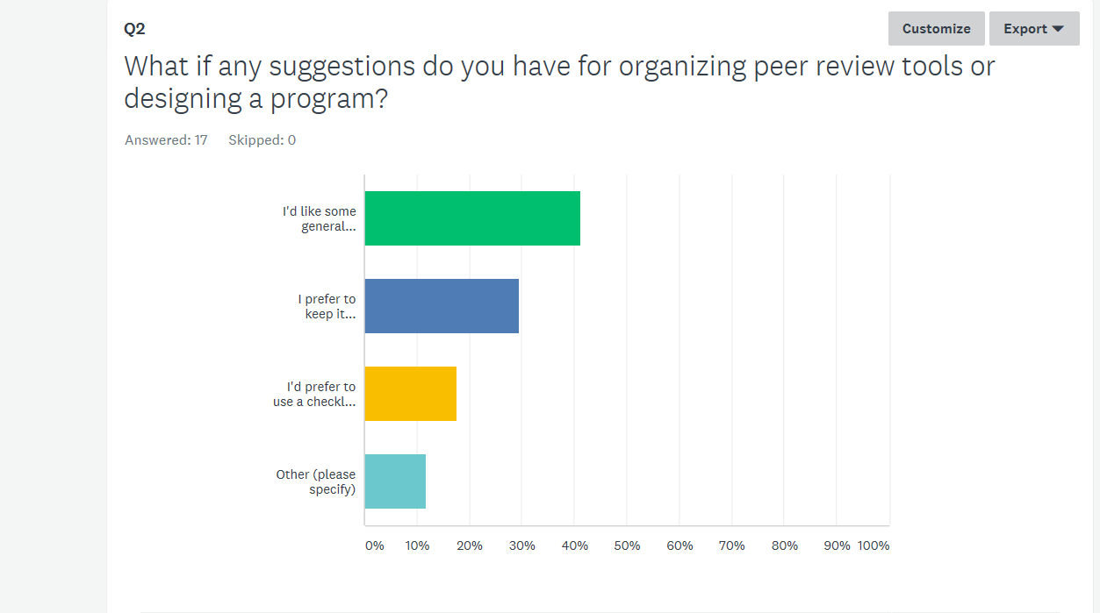
I'd like some general guidance about a good process | 41.18% 7
I prefer to keep it unstructured | 29.41% 5
I'd prefer to use a checklist that helps with observation and feedback | 17.65% 3
Other (please specify)

Slide 4
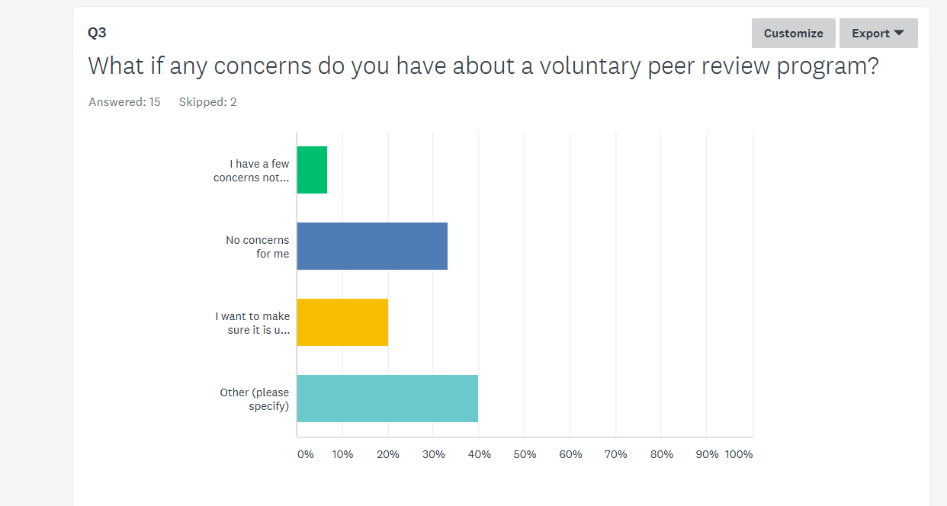
I have a few concerns noted below | 6.67% 1
No concerns for me | 33.33% 5
I want to make sure it is used for formative purposes only | 20.00% 3
Responses Other (please specify)

