Slide 1
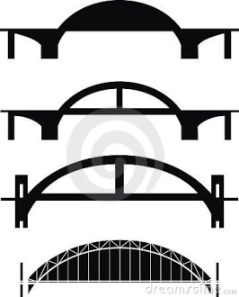
Clinical Pedagogy Across the Curriculum
Dean Connie Mayer
Prof. Sarah Rogerson
Prof. Ray Brescia

Slide 2
Law and Social Innovation:
Creative Problem Solving

Slide 3
ABA Report on Legal Education and Professional Development: “The MacCrate Report” (1992).
10 Skills Required of the Modern Lawyer.
#1: Problem Solving.

Slide 4
“Best Practices for Legal Education” (2007)
One of the core competencies law students should develop and law schools should cultivate is “the ability to resolve legal problems effectively and responsibly.”
Best Practices, p. 43.
“Law schools can provide opportunities for students to engage in context-based learning in hypothetical as well as real life contexts. Ideally, law schools should present students with progressively more challenging problems as their self-efficacy, lifelong learning skills, and practical judgment develop.”
Best Practices, p. 105.

Slide 5
Schultz & Zedeck: 26 Lawyering Effectiveness Factors (2009)
1. Analysis and Reasoning: Uses analytical skills, logic, and reasoning to approach problems and to formulate conclusions and advice.
2. Creativity/Innovation: Thinks “outside the box,” develops innovative approaches and solutions.
3. Problem Solving: Effectively identifies problems and derives appropriate solutions.
4. Practical Judgment: Determines effective and realistic approaches to problems.

Slide 6
What the Best Law Teachers Do
“The teachers in the study produce exceptional learning…[Students in their classes] learn core lawyering skills, including attention to detail, close reading, communication, advocacy, and legal reasoning. Students also learn the problem-solving skills and the judgment needed to draft documents and address client needs.”
pp. 21-22

Slide 7
What the Students Do
Work with local officials to address actual, complex legal and policy problems city government is facing.
Gather facts using traditional research, site visits, surveys, etc.
Interview local officials, stakeholders, community activists, consumers, potential end users.
Work in teams; critique each others’ work.
Prepare written communications in two formats:
Brief “one-pagers” on their given topic.
End-of-Semester white paper on the topic
Present findings and ideas in two formats:
Short, “pitch” sessions.
Longer, full briefing sessions.

Slide 8
Clinical Pedagogy and Problem Solving
Issue Spotting
Field Research
Interviewing
Fact Gathering
Active Listening
Legal Analysis
Empathy
Oral and Written Communication and Advocacy
Working in Groups
Peer-to-Peer Critique of Written and Oral Work

Slide 9
Dan Pink: A Whole New Mind “High Touch/High Concept” aptitudes that are needed in the new “Conceptual” age.
Design: creating something beautiful or engaging.
Story: telling a compelling narrative.
Symphony: synthesizing -- seeing the big picture and marshalling/coordinating resources.
Empathy: forging relationships.
Play: engaging lightheartedly.
Meaning: pursuing fulfillment.

Slide 10
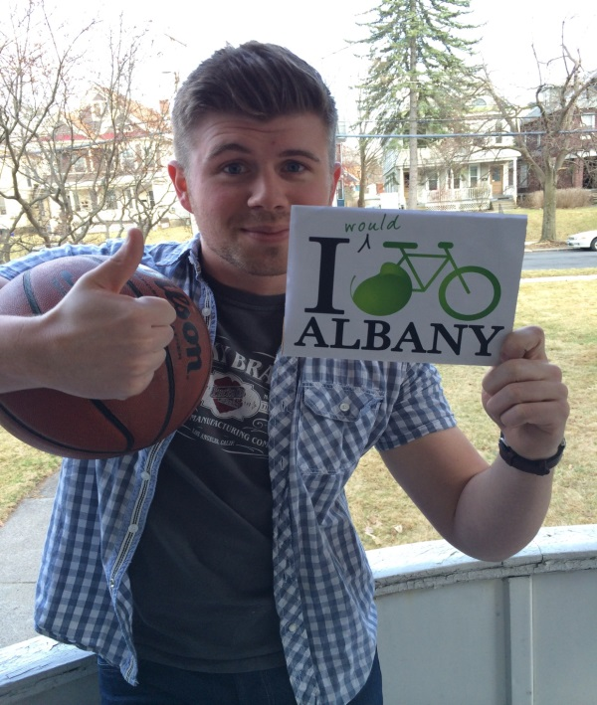
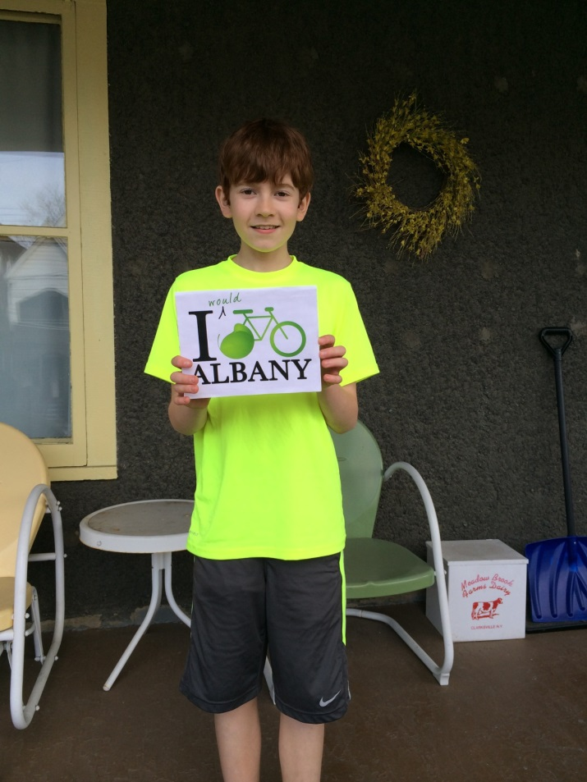
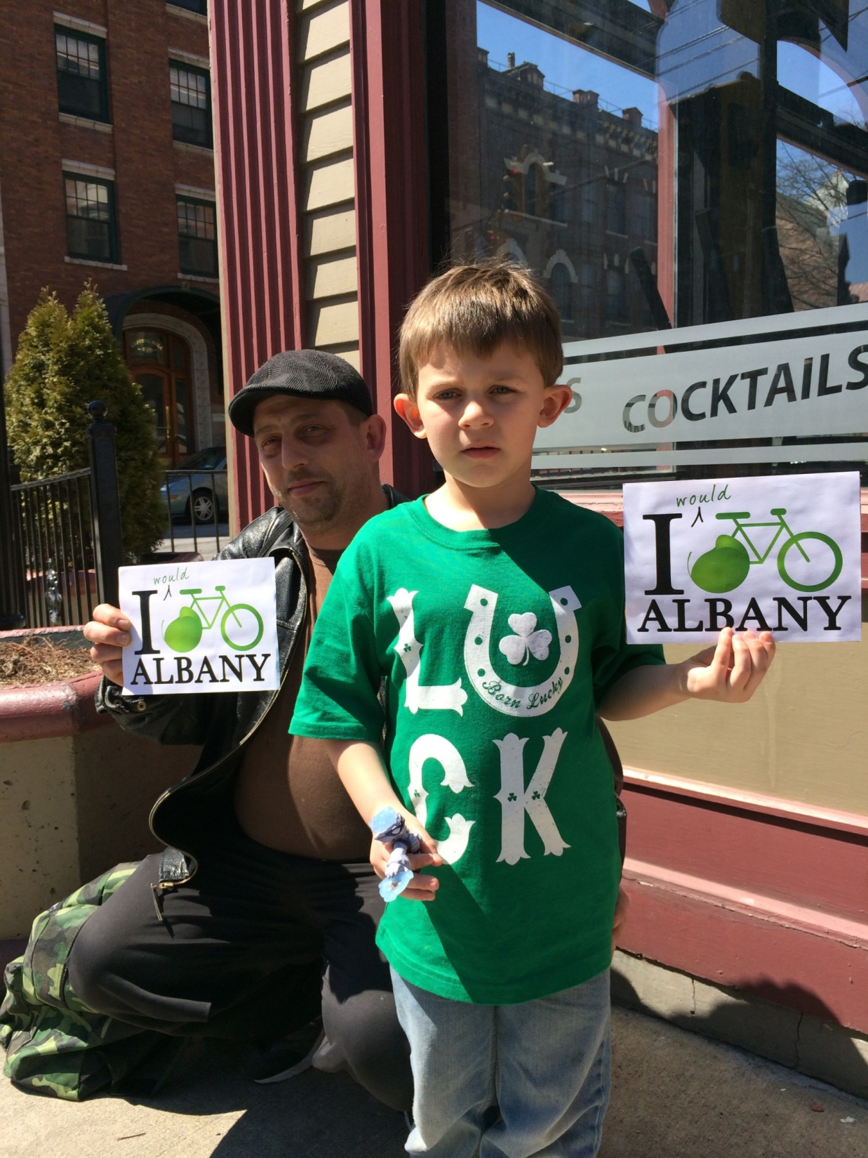
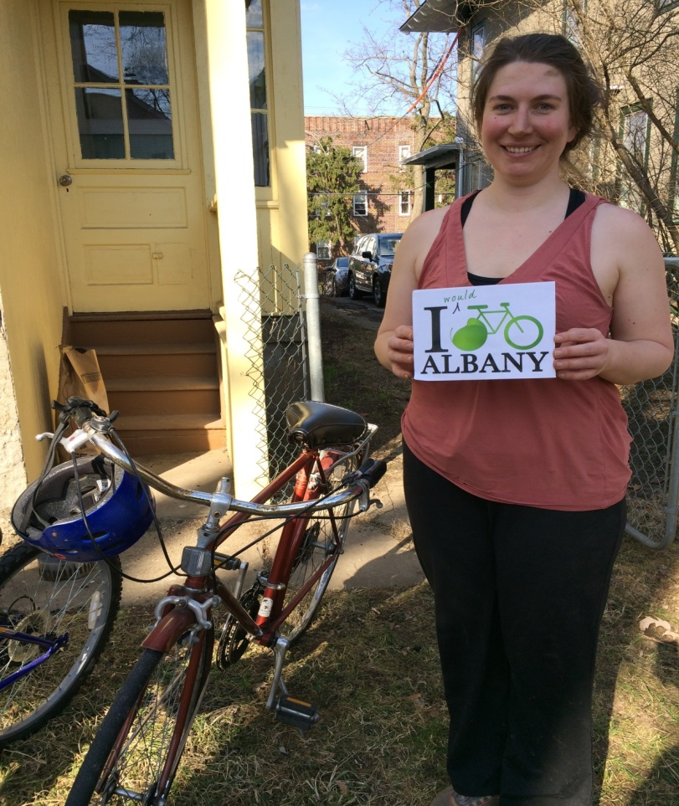
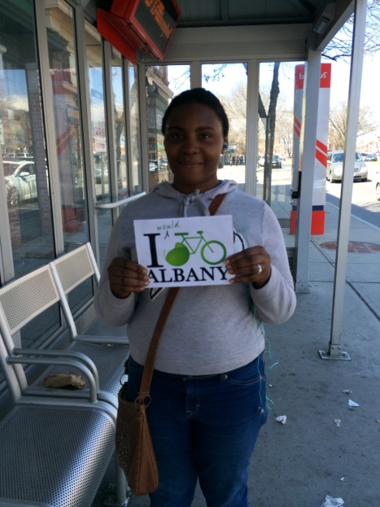
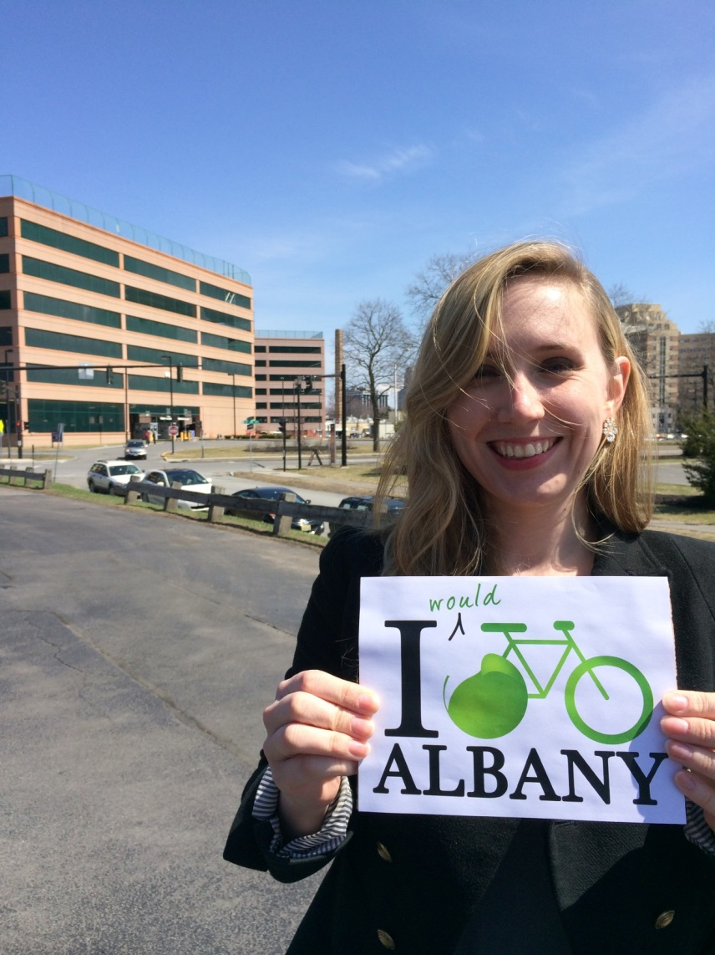
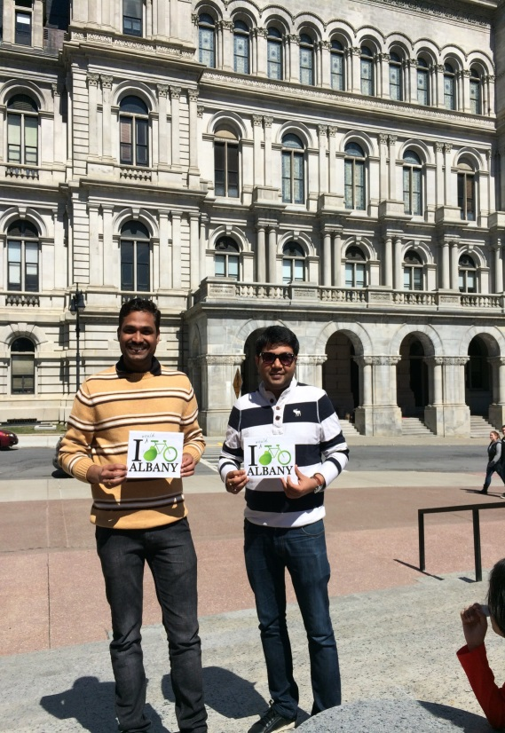
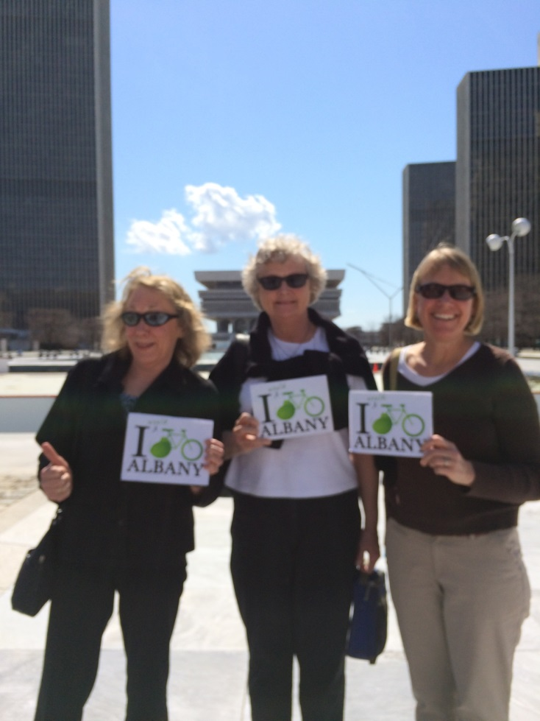
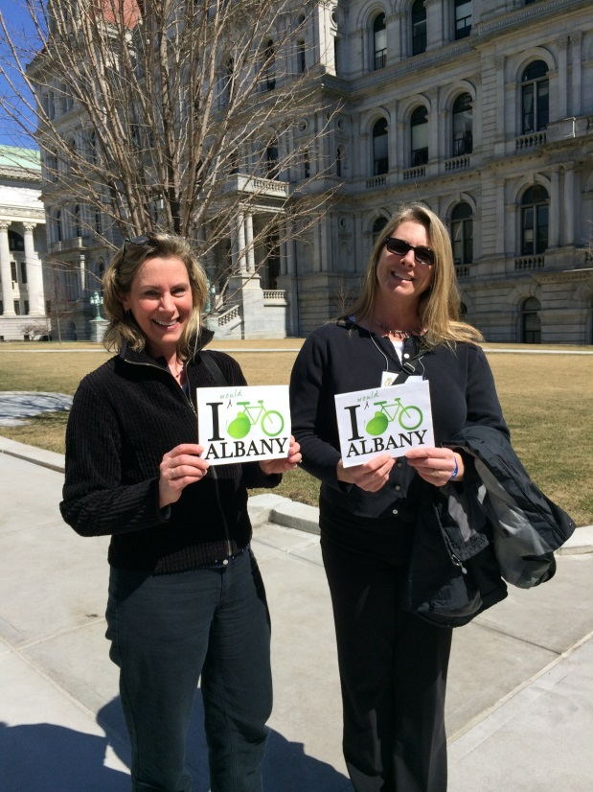

Slide 11
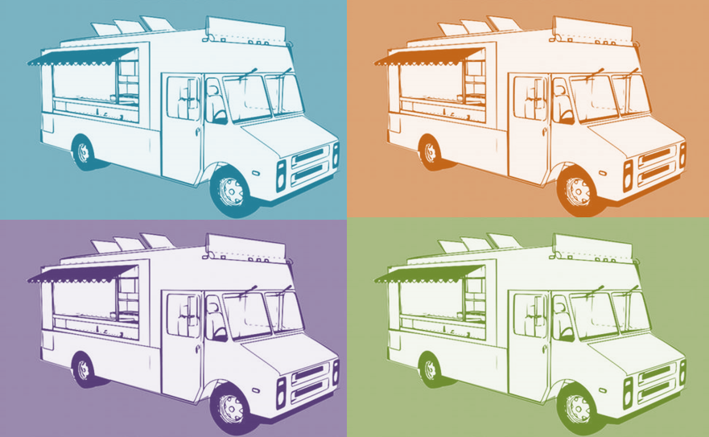
The (51ATE) Plan
Proposed Changes to Albany’s Food Truck Infrastructure
Notes:
To rectify this problem, we bring you the 51ATE Plan.
It is our hope that this plan can revitalize food entrepreneurship in Albany and promote small business culture within the city.

